Slide 1
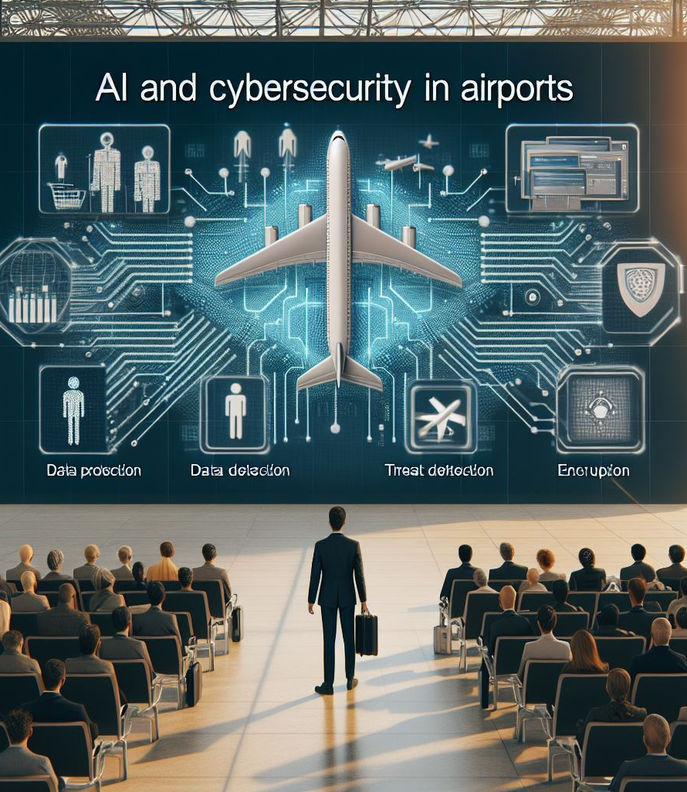
AI and Cybersecurity in Airports
Costas Tziazas | Information Security Officer |May 2024

Slide 2
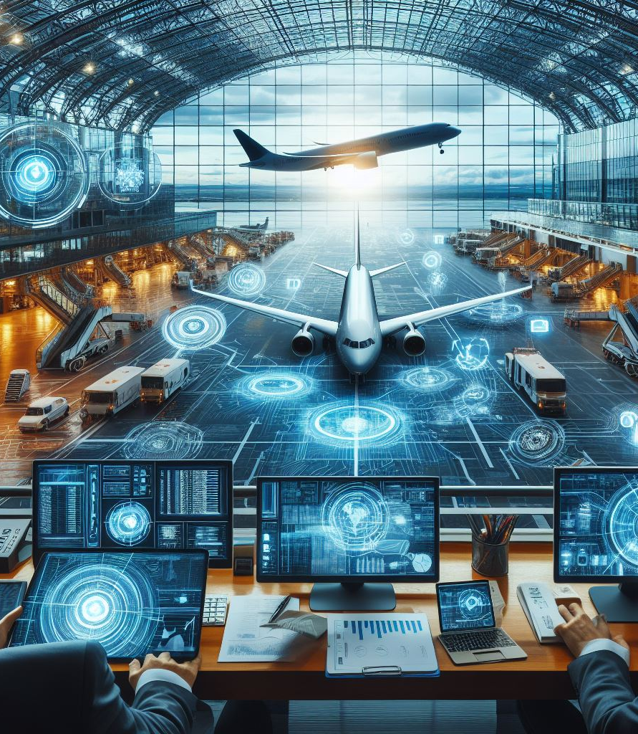
Hermes is the operator of Larnaka and Pafos International Airports.
In May 2006, Hermes Airports Ltd undertook the operation and management of Larnaka and Pafos International Airports, under a 25-year BOT (Build-Operate-Transfer) concession agreement with the Republic of Cyprus.
We are a Cyprus based registered company with an international consortium of 9 shareholders, representing a mix of Cypriot and international partners.
Notes:
Eventually our main purpose is to provide an excellent and above all safe passenger experience !! As many people say in our industry, we are the first and last face that a visitor sees when entering a country

Slide 3
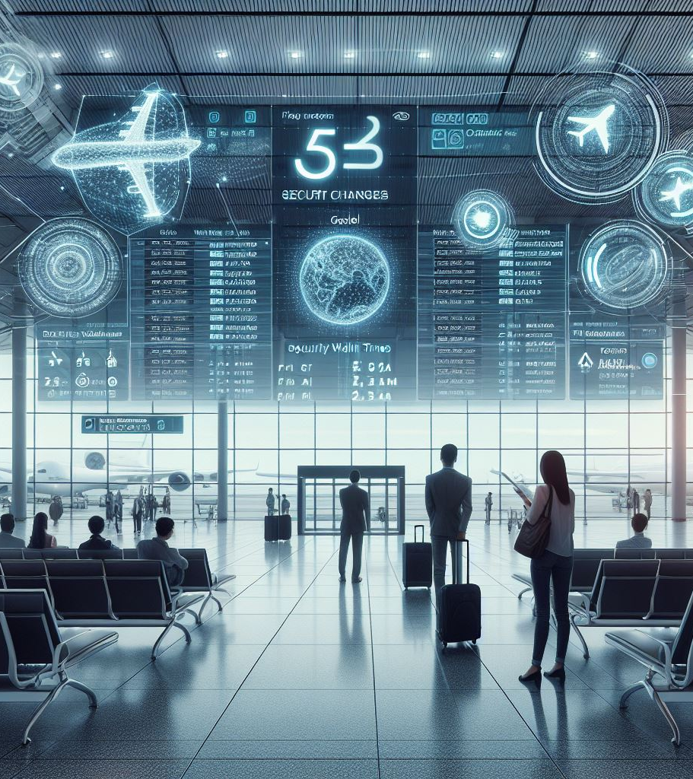
Artificial intelligence (AI)Definitions
Technology that can, for a given set of human-defined objectives, generate outputs such as content, predictions, recommendations, or decisions influencing the environments they interact with.
Reference : EASA : Artificial Intelligence Roadmap 2.0 – Human Centric Approach to AI in Aviation
While there is no single accepted definition, artificial intelligence (AI) are technologies that combine the raw computing power of machines with the cognitive power to think, learn and make decisions. In the context of this paper, the term AI can be used to describe a wide variety of technologies and functionalities (e.g. machine learning, deep learning, artificial neural networks, knowledge-based reasoning…), which enable a machine’s ability to perform simple tasks extremely well, possibly even better than humans
International Civil Aviation Organization WORKING PAPER A40-WP/2681

Slide 4
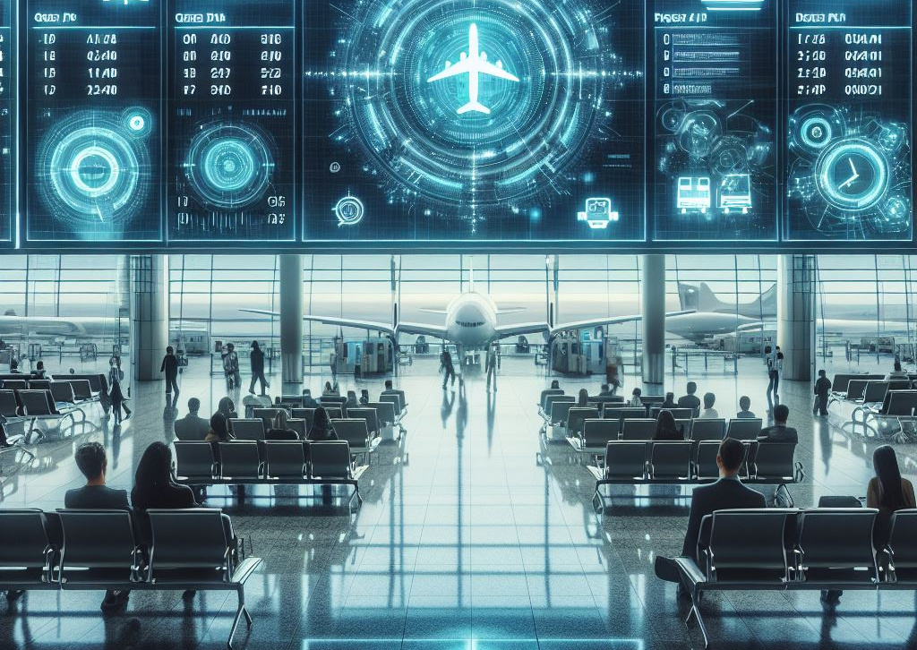
Cybersecurity Threats and Challenges in Airports
Ransomware Attacks
Phishing and Social Engineering
Insider Threats
Supply Chain Vulnerabilities
IoT and OT Security Risks
State-Sponsored or Organized Crime Syndicates
Distributed Denial of Service (DDoS) Attacks
Security Updates/ Patching
Complex and Unique Environments /Interoperability
Data Privacy and Compliance
Resource and Time Constraints
Skills Gap
User Awareness
Notes:
Hermes is committed and has invested in state-of-the-art technologies not only to improve operational effectiveness and improve customer experience, but also to enhance our infrastructures cybersecurity resilience. Some examples are the renewal of IT backbone infrastructure by replacing legacy network equipment ( Routers, Core Switches, Switches, introducing internal firewalls) as well as updating our datacenters In terms of hardware availability, the current infrastructure is using Virtualization Technology (VMWare), and it is based on the vSAN technology and VXRail platform of Dell. The platform offers full redundancy in all levels (CPU, Memory and Storage) and it is configured in a stretched cluster across the two terminals. Using the above technology, we can have two Active Datacenters (one LCA and one PFO) and the applications can be hosted in any of the two Data Centers without affecting the user’s experience ( Improving our Business Continuity capabilities in terms of technology)

Slide 5
Role of AI in Cybersecurity
AI Assistant (HackerGPT, Microsoft Copilot, CISCO AI Assistant)
Automatic Disruption of Advanced Cyberattack
XDR-Prioritized Incidents
Auto-Heal Affected Assets
Proactive Threat Hunting
Advanced analytics and automated workflows help you understand your organization's cyberthreat landscape and vulnerabilities
Advanced Imaging Technology (AIT) systems used at airport security checkpoints with a new artificial intelligence-based algorithm
Notes:
Only recently we have been assessing cybersecurity products that incorporate AI technology to improve even more our understanding of the threat and vulnerability landscape within our organization to take corrective actions but also to improve our incident respond capabilities.

Slide 6
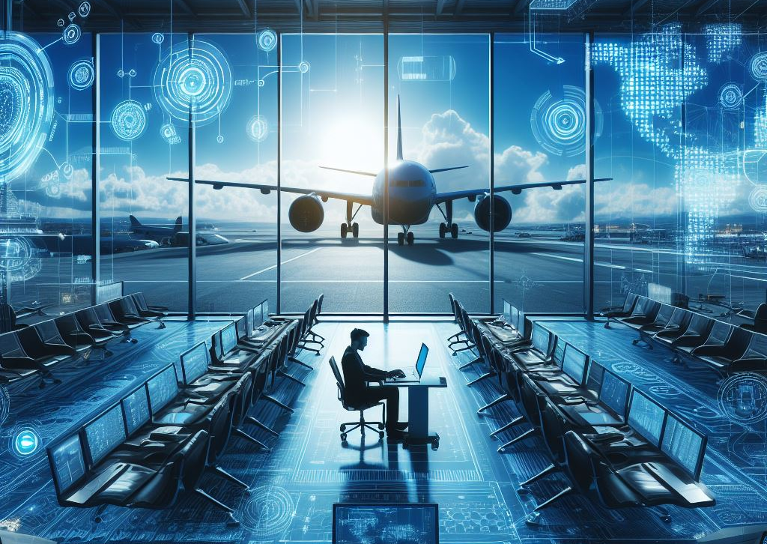
Compliance
EASA Part- IS
The aerodrome operator shall establish, implement and maintain an information security management system in accordance with Delegated Regulation (EU) 2022/1645 ( 1 ) in order to ensure the proper management of information security risks which may have an impact on aviation safety. Applicable from 16 October 2025 Delegated Regulation (EU) 2022/1645
Reference: Easy Access Rules for Aerodromes
NIS -2 Directive
The Directive 2022/2555 “NIS-2” aims at improving cybersecurity risk management and reporting obligations in a wide range of sectors, including air transport.
Member States have to transpose the NIS2 Directive into national law by 17 October 2024

Slide 7
Compliance
AI Act
European Union lawmakers gave final approval to the AI Act in March 2024, making it the world-leading set of rules for AI.
The AI Act will enter into force 20 days after its publication in the Official Journal and will be fully applicable 2 years later. However, there are some exceptions:
Prohibitions will take effect after six months.
Governance rules and obligations for general-purpose AI models become applicable after 12 months.
Rules for AI systems embedded into regulated products will apply after 36 months
Applicability: The AI Act will likely be published in the Official Journal of the EU between May – July. Twenty days after publication, the law will enter into force and become applicable between late 2024 – summer 2027

Slide 8
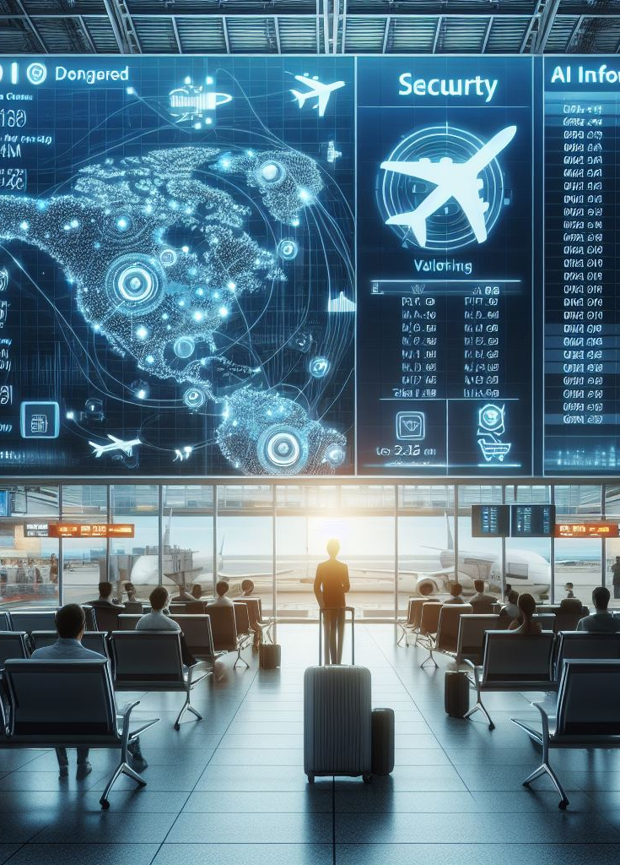
ISO : Can you please provide with the key differences between EASA part IS and NIS2
Petal AI : Based on the provided document snippets, I can provide some key differences between EASA Part IS and NIS2:
Scope: EASA Part-IS applies to production organizations, design organizations, aerodrome operators, and apron management service providers in the aviation industry. On the other hand, NIS2 applies to DNS service providers, TLD name registries, entities providing domain name registration services, cloud computing service providers, data center service providers, content delivery network providers, managed service providers, managed security service providers, online marketplaces, online search engines, and social networking services platforms.
Purpose: EASA Part IS focuses on the management of information security risks with a potential impact on aviation safety. NIS2, on the other hand, aims to ensure a high common level of cybersecurity across the European Union.
Information Security Management System (ISMS): EASA Part-IS requires organizations to establish, implement, and maintain an ISMS to manage information security risks. NIS2 does not specifically mention the requirement for an ISMS.
Risk Assessment: EASA Part-IS requires organizations to conduct information security risk assessments to identify and evaluate potential risks. NIS2 also includes provisions for risk assessment, but it focuses on the broader context of network and information systems security.
Registry of Entities: NIS2 mandates ENISA to create and maintain a registry of entities such as DNS service providers, cloud computing service providers, and online marketplaces. EASA Part IS does not include a similar requirement for a registry of entities.
Please note that these differences are based on the provided document snippets, and there may be additional differences between EASA Part IS and NIS2 that are not mentioned here.

Slide 9
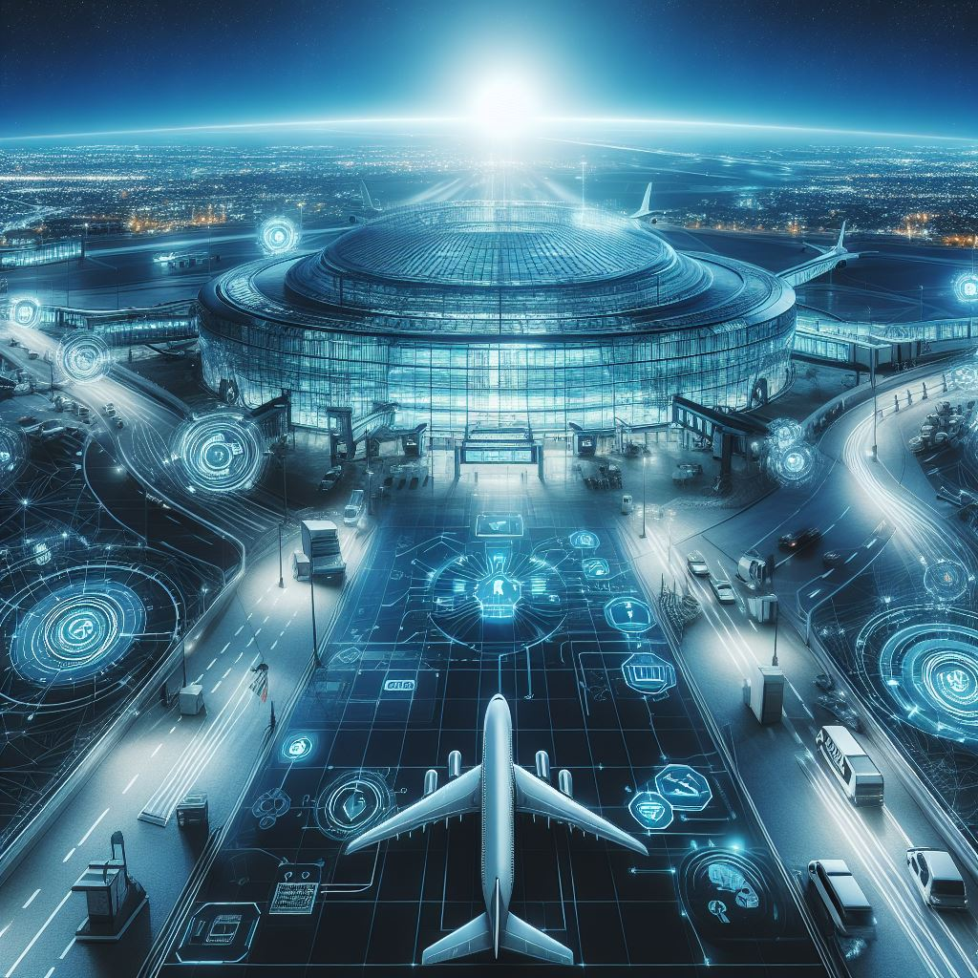
Current Challenges – Can AI Assist ?
Operational effectiveness is prioritized over a secure environment.
Due to the nature of airports (operational 24/7), performing security updates and patches is not easy.
Information Security System interoperability is hindered by legacy systems, vendor immaturity, and several stakeholder systems that need to exchange data.
There is a skill gap in terms of operational technology at airports, which is not widely recognized by the general Infosec Industry, such as Baggage Handling Systems and CT Scanners.
It is often believed that segregation of networks, whether logical or physical, is always a good mitigation measure.
Chief Information Security Officers are often only recognized and consulted during times of crisis.
Users are not actively engaged in information security, assuming it is not their job

Slide 10
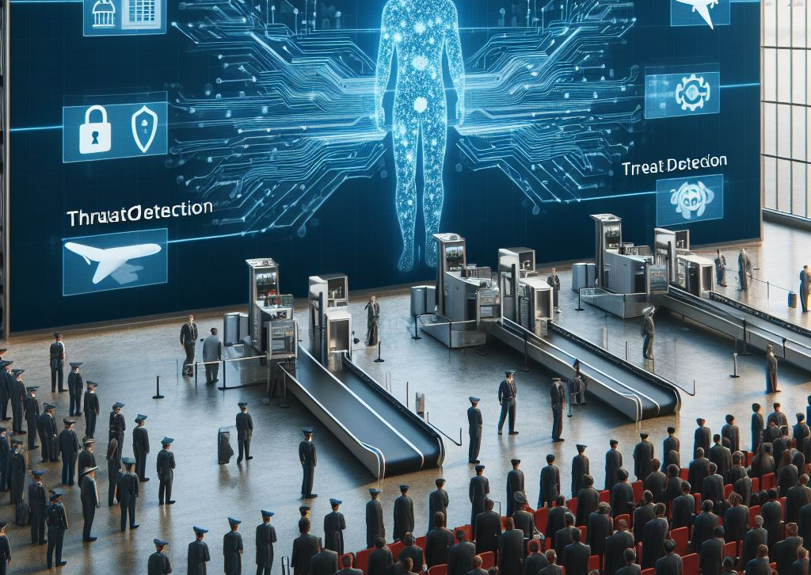
Risk Management
In our approach to information security, we prioritize a risk-based methodology, ensuring that our efforts align closely with the potential impact and likelihood of security threats. We actively engage our business stakeholders to understand their unique requirements and risk tolerances, allowing us to tailor our security measures effectively. Through comprehensive risk assessments, we identify and prioritize information security risks, presenting clear insights and recommendations to stakeholders.
While we provide guidance and advocate for best practices, it's crucial to recognize that our role is advisory in nature. Ultimately, the responsibility for implementing and maintaining robust security measures rests with each individual and department. Embracing this accountability ensures that we collectively contribute to a strong and resilient security posture across the organization

Slide 11
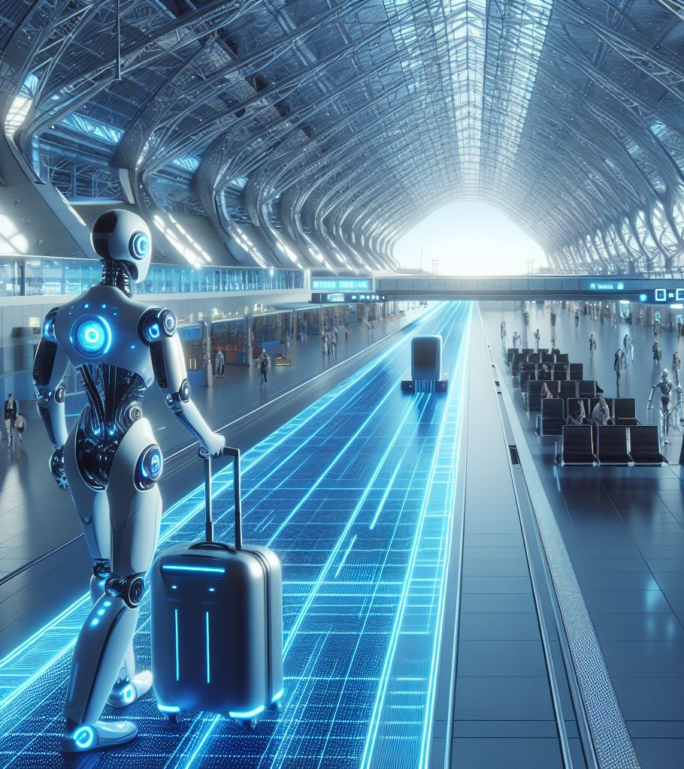
Conclusion
Adhering to best practices in cybersecurity is essential for safeguarding airports against evolving threats. By addressing challenges such as operational constraints, interoperability issues, skill gaps, and CISO visibility, airports can enhance their security posture and mitigate risks effectively.
By leveraging AI-powered cybersecurity solutions, airports in Europe can enhance their resilience to cyber threats, protect critical assets and infrastructure, and safeguard the safety and security of passengers and employees
Artificial Intelligence (at the moment) is nothing but a tool, a powerful one, but a tool nonetheless and it depends on us (the people) on how to wield it.
Reference: Costas Tziazas - Information Security Officer
Notes:
The conclusion of the presentation is that adhering to best practices in cybersecurity is essential for safeguarding airports against evolving threats. By addressing challenges such as operational constraints, interoperability issues, skill gaps, and CISO visibility, airports can enhance their security posture and mitigate risks effectively. By leveraging AI-powered cybersecurity solutions, airports in Europe can enhance their resilience to cyber threats, protect critical assets and infrastructure, and safeguard the safety and security of passengers and employees.

Slide 12
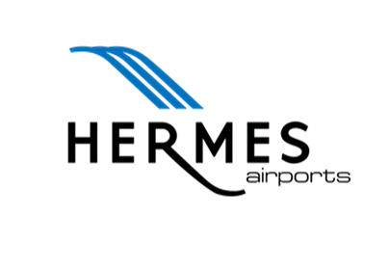
Thank you
Costas Tziazas | Information Security Officer |May 2024

